Slide 1
C H COLE & SONS
Effects of public access on Millhouse and Cherry Orchard Farms

Slide 2
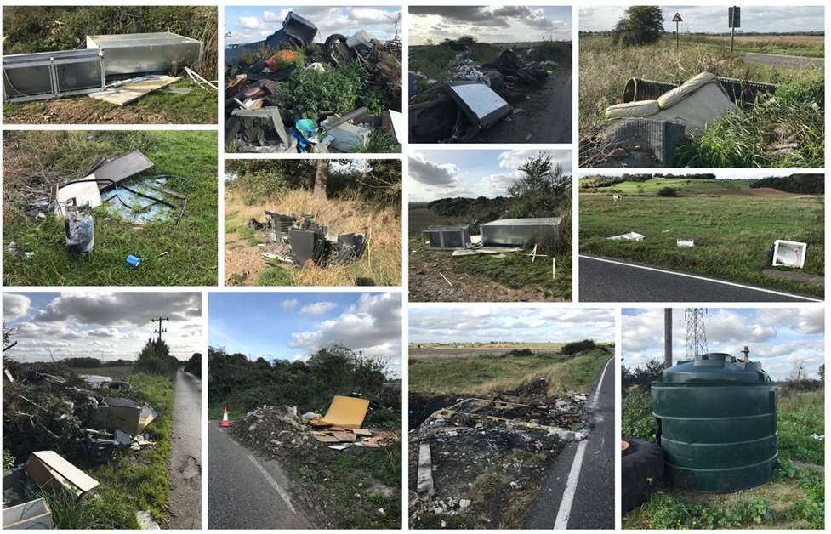
Fig. 1 - Fly Tipping – all of these images were taken on the same day at Mill House Farm

Slide 3
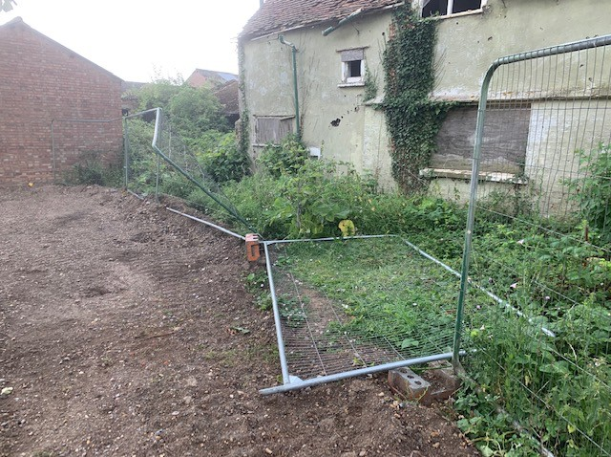
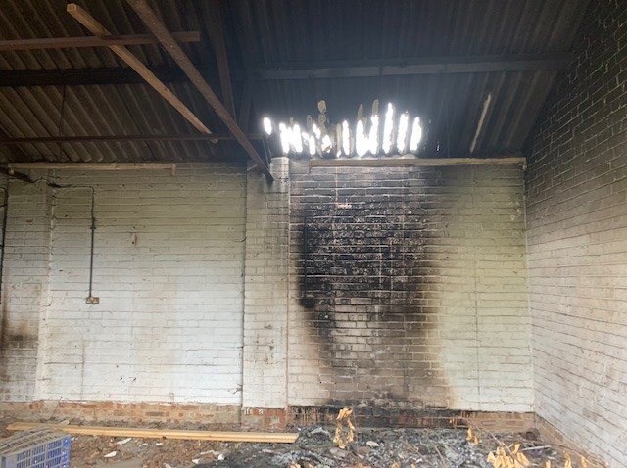
Figs. 2 & 3 - Fence demolished (left) on FP 81 and fire started by youths causing several thousand pounds worth of damage

Slide 4
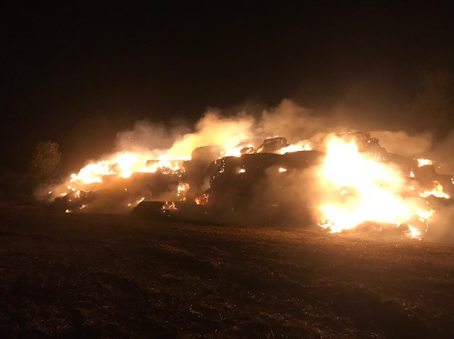
Fig. 4 - £8500 worth of straw bales set alight by children, accessed via Green Lane Bridleway (101)

Slide 5
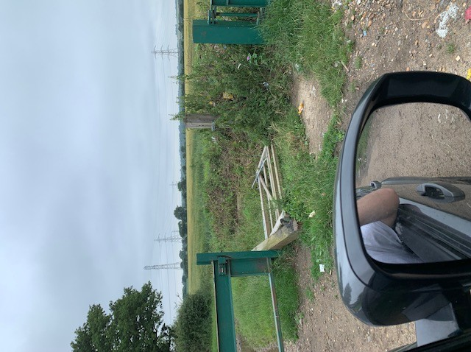
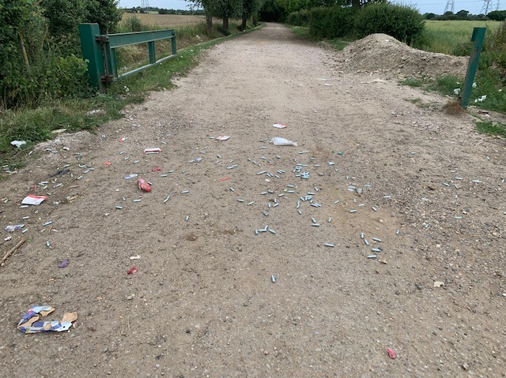
Fig. 5 & 6 - Green Lane (BW101)
Hundreds of Nitrous Oxide cylinders dumped on the Bridleway and gates destroyed by hare coursers to gain field access

Slide 6
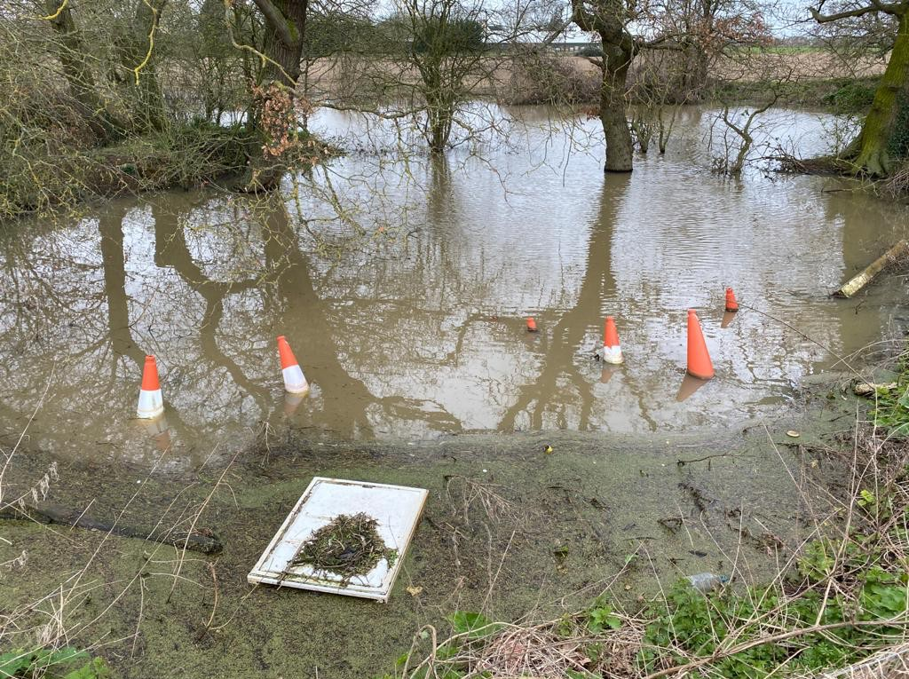
Fig. 7 - Traffic cones thrown into a wildlife-rich pond using Footpath 79 as an access.

Slide 7
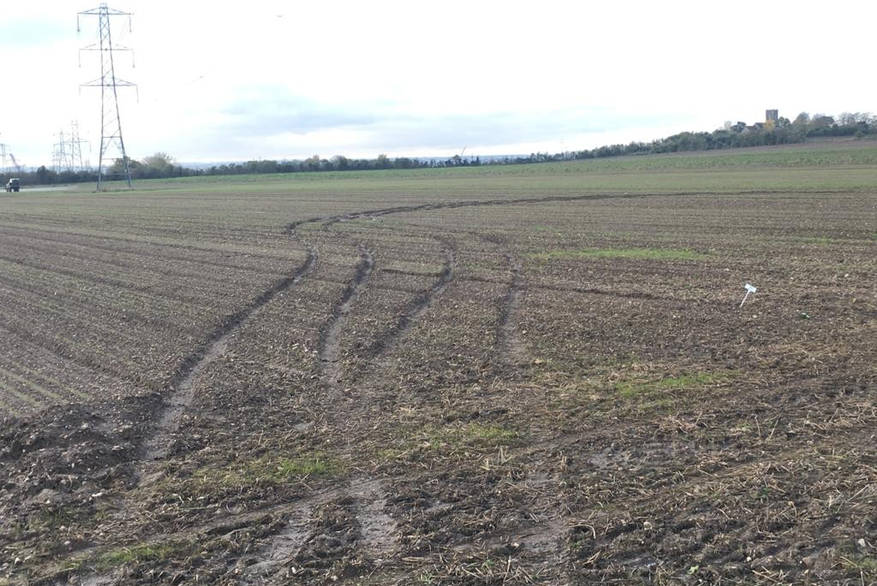
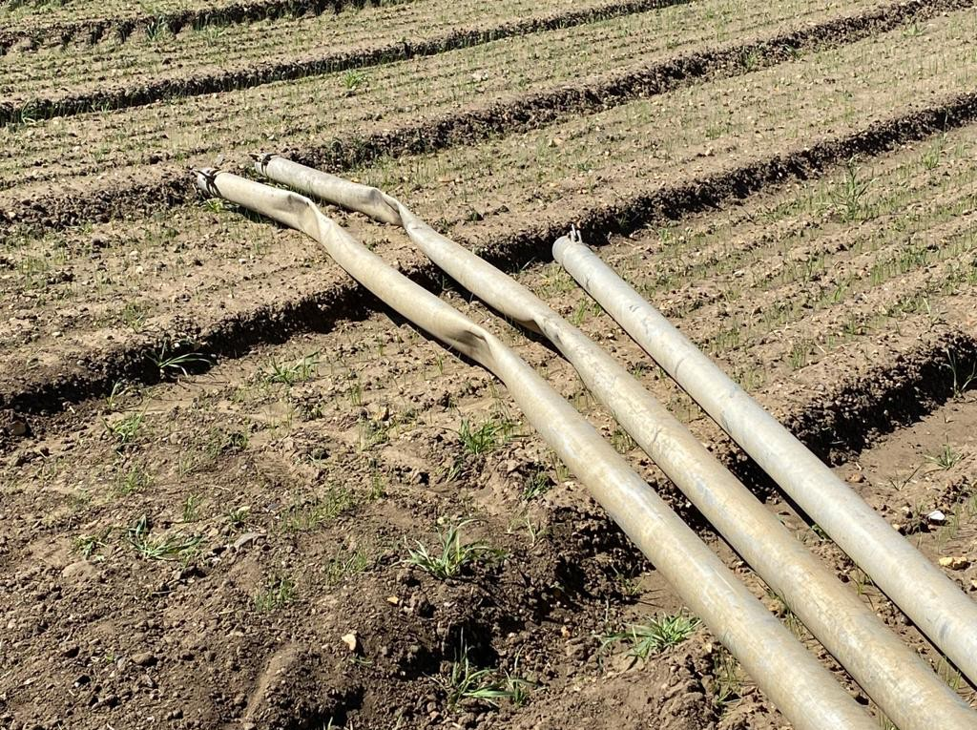
Fig. 8 & 9 - Accessed via Footpath 67, serious damage caused by a 4x4 on a high value crop of winter salad onions and to the irrigation pipes serving the field

Slide 8
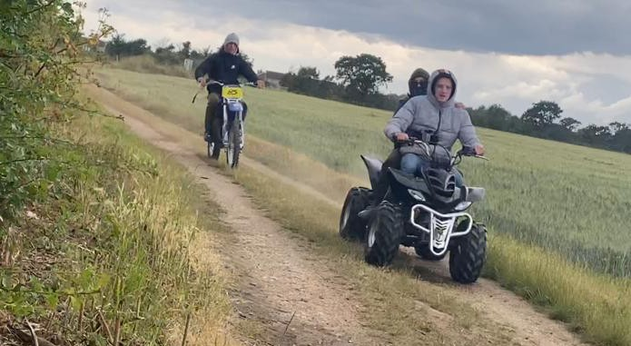
Fig. 10 - Motorbikes and quad bikes caught of FP64

Slide 9
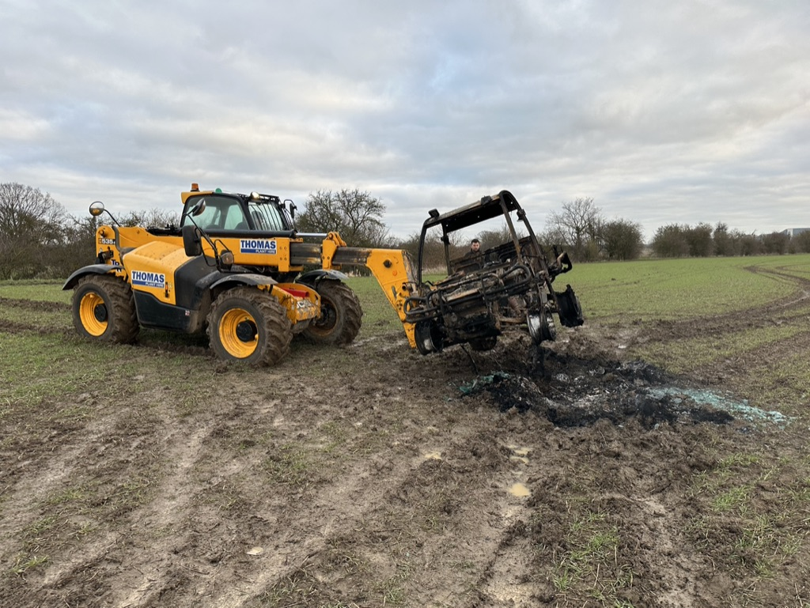
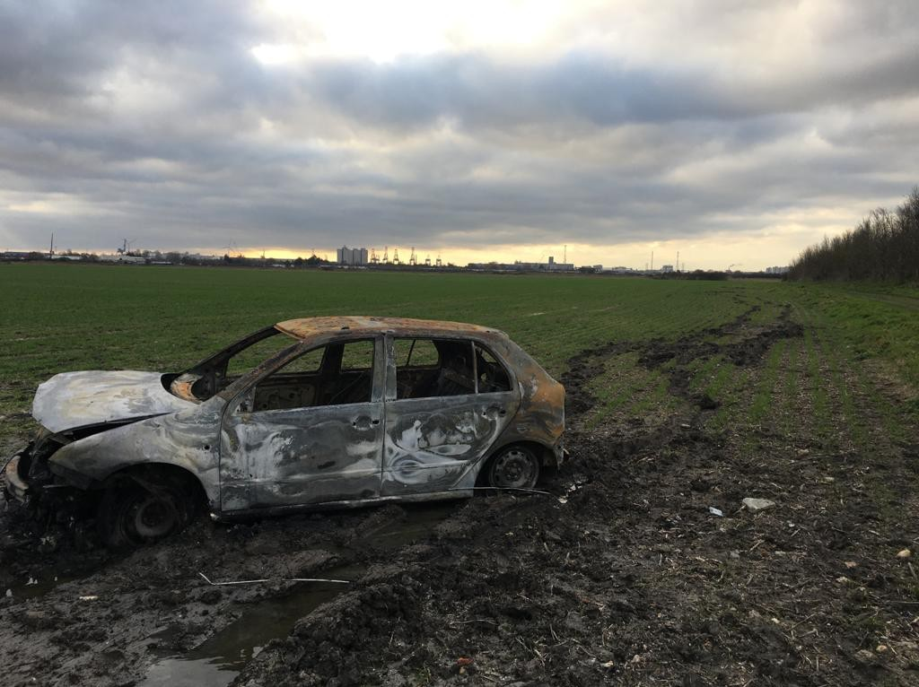
Figs 11 & 12 - Stolen and burned-out vehicles abandoned on fields, causing pollution and soil damage. These accessed via Mardyke Way (BW219)

Slide 10
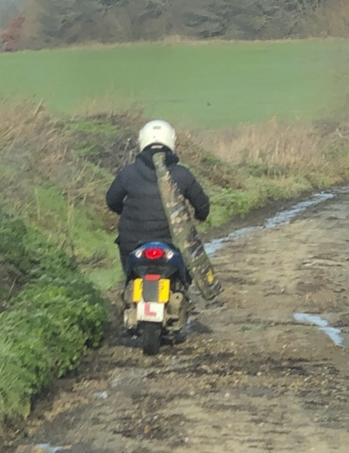
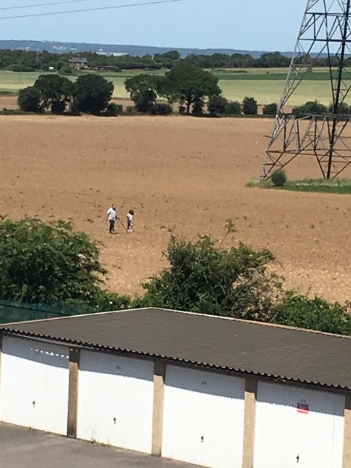
Figs. 13 & 14 - Motorbike rider armed with a shotgun for poaching Rainbow Lane and Metal detectorists working without permission at Mill House farm, accessed by FP78

Slide 11
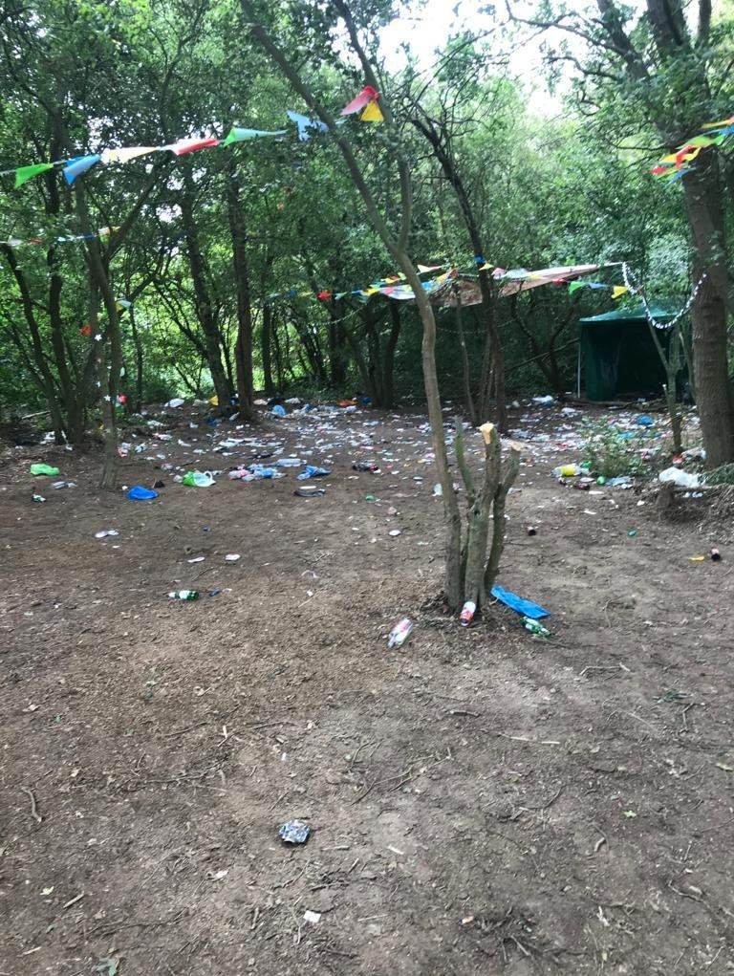
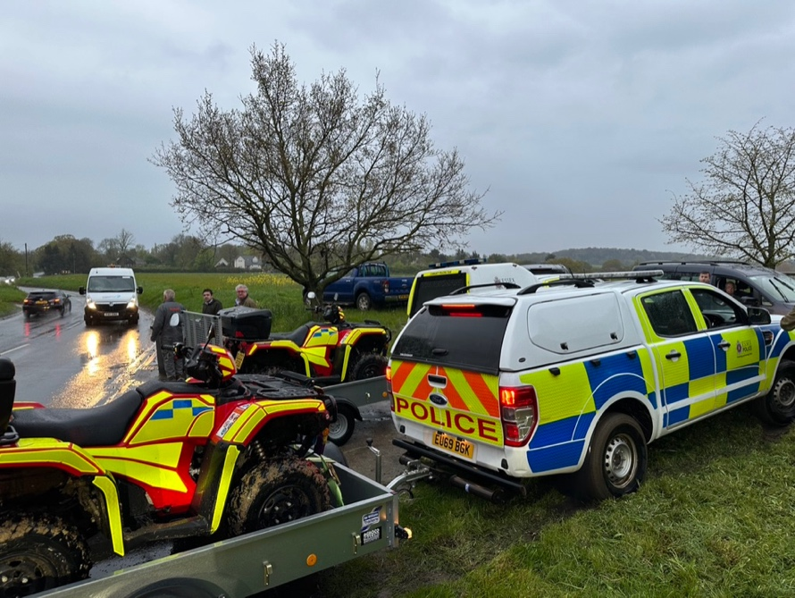
Figs. 15 & 16 - The aftermath of an illegal rave, accessed via Green Lane and Mardyke bridleways and Police attend yet another hare coursing incident at Cherry Orchard Farm

